Slide 1

Day 1
Course Overview & Fundamentals for Machine Learning in Python

Slide 2
Plan for the Week
Day 1: Intro & Review
Introduction & Course Overview
Review of Fundamentals for Machine Learning in Python
Day 2: Intro to Classification Algorithms
Probability Theory
Common & Probabilistic Classifiers
Day 3: Tree-Based Methods for Classification
Decision Tree
Random Forest
Day 4: Neural Networks
Perceptron (Single & Multilayer) & ADALINE Networks
Optimization, Backpropagation, & Learning Rules
Day 5: Deep Learning (Neural Networks Cont.)
Brief Background
Convolution Networks
Tensorflow & Keras

Slide 3
Learning Objectives
By the end of the course, students should be able to:
Understand the mathematical and statistical foundations of common classification algorithms
Identify the most appropriate algorithm based on data characteristics and analysis goals
Implement classification algorithms in Python
Evaluate model performance based on classification metrics

Slide 4
Course Structure & Delivery
Class is from 9:00 AM – 3:30 PM (6.5 hours)
This will be broken up into 3 sessions
Session 1 (2.25 hours)
9:00 AM – 11:15 AM
Lunch (1 hour)
11:15 AM – 12:15 PM
Session 2 (2.25 hours)
12:15 PM – 2:30 PM
Break (10 minutes)
2:30 PM – 2:40 PM
Session 3 (50 minutes)
2:40 PM – 3:30 PM

Slide 5
Course Structure & Delivery
Session 1 (2.25 hours)
Introduce Topic → ~ 1 hour
Guided Example & Walkthrough → ~ 30 minutes
In-class Exercise → ~ 45 minutes
Session 2 (2.25 hours)
Same format
Session 3 (50 minutes)
Introduce Light Topic/Next Day
Learning Evaluation
Questions/Recap of the Day

Slide 6
Plan for the Week
Day 1: Intro & Review
Introduction & Course Overview
Review of Fundamentals for Machine Learning in Python
Day 2: Intro to Classification Algorithms
Probability Theory
Common & Probabilistic Classifiers
Day 3: Tree-Based Methods for Classification
Decision Tree
Random Forest
Day 4: Neural Networks
Perceptron (Single & Multilayer) & ADALINE Networks
Optimization, Backpropagation, & Learning Rules
Day 5: Deep Learning (Neural Networks Cont.)
Brief Background
Convolution Networks
Tensorflow & Keras

Slide 7
Plan for the Week
Day 1: Intro & Review
Introduction & Course Overview
Review of Fundamentals for Machine Learning in Python
Day 2: Intro to Classification Algorithms
Probability Theory
Common & Probabilistic Classifiers
Day 3: Tree-Based Methods for Classification
Decision Tree
Random Forest
Day 4: Neural Networks
Perceptron (Single & Multilayer) & ADALINE Networks
Optimization, Backpropagation, & Learning Rules
Day 5: Deep Learning (Neural Networks Cont.)
Brief Background
Convolution Networks
Tensorflow & Keras

Slide 8
What is Machine Learning?
“A field of Computer Science that gives computers the ability to learn without being explicitly programmed.”
Arthur Samuel (Coined the term in 1959 at IBM)
“The ability [for systems] to acquire their own knowledge, by extracting patterns from raw data.”
Deep Learning, Goodfellow et al
“A computer program is said to learn from experience E with respect to some set of tasks T and performance measure P if its performance tasks in T, as measured by P, improves with experience E.”
Tom Mitchell (Computer Scientist & Professor at Carnegie Mellon)

Slide 9
Types of Machine Learning
There are three main types of Machine Learning:
Supervised
Unsupervised
Reinforcement

Slide 10
Types of Machine Learning
There are three main types of Machine Learning:
Supervised
Unsupervised
Reinforcement

Slide 11
Supervised Learning
For each input, there is a target value (label) associated with it
Know the right answer ahead of time
Classification and Regression are subsets of supervised learning
This course will focus specifically on classification
Common Examples
Classifying Fraudulent Credit Card Transactions
Identifying tumors within X-ray images
Predicting the price of a house given its characteristics

Slide 12
Types of Machine Learning
There are three main types of Machine Learning:
Supervised
Unsupervised
Reinforcement

Slide 13
Unsupervised Learning
For each input, there is no target value (label) associated with it
Do not know the right answer
No error to evaluate in our model
Examples of unsupervised learning
Clustering (Customer Segmentation)
Dimensionality Reduction (Principal Components Analysis)
Anomaly Detection (Outlier Analysis)

Slide 14
Types of Machine Learning
There are three main types of Machine Learning:
Supervised
Unsupervised
Reinforcement

Slide 15
Reinforcement Learning
For each input, there is no target value (label) associated with it
Area of ML inspired by behavioral psychology
Concerned with how agents should act in their environment so as to maximize some cumulative reward.
Examples of Reinforcement Learning
Self-driving car
Chess bot

Slide 16

Programming Languages
Need framework to implement Machine Learning algorithms
There are hundreds of programming languages
https://en.wikipedia.org/wiki/List_of_programming_languages
This course will use Python

Slide 17
Why Python?
There are several benefits to using python for Machine Learning
Interpreted Language
No need to compile & easier to implement
Dynamic Typing
No need to declare variable types and then assign them
Strong Typing
Once a value is initialized and saved, it is never coerced. Type casting must be done explicitly
High Level
More human readable (white space matters)
Machine Learning & Deep Learning APIs
Scikit-Learn, Tensorflow, Keras, CNTK, Apache MXNET, PyTorch, etc.

Slide 18
Why Do We Need Math?
There’s lots of ML code out there that you can just download and run
To get useful insights & meaningful results, you need to understand the mathematical underpinnings
Knowing the algorithms helps you know when to choose each one for a given problem
Recognize over/underfitting
Troubleshooting poor/ambiguous results

Slide 19
Software & Tech Stack
The software and frameworks we will be using are as follows:
Language
Python 3.5 (Anaconda Distribution)
ML/DL Frameworks
scikit-learn & Keras
IDE
Spyder
Course Content Delivery
Github
Comunication
Slack

Slide 20
Setting up Slack
Invite Link:
https://join.slack.com/t/hpsi-classification/shared_invite/enQtMjk5MjQzMTMxNzM1LTA2NDU2NTcyZGVjZDlkZThhNjZmN2MwYThmNWI2ZTZlYTI2OTQyOTkyN2M4MmE4OWZkMzFmNzY5MWJmYjZjNTc

Slide 21
Getting Access to the Course Content on GitHub
If you do not have a GitHub account, please go to the following link and make one:
https://github.com/join?source=header-home
Send your GitHub username to us through the #github-usernames channel on Slack
You should receive an email inviting you to collaborate to the HPSI-Classification repository
Clone the repository
Move the repository from your Downloads folder to your Desktop or Documents folder

Slide 22
Tech Stack Setup & Testing of Working Environment
Follow the instructions in the README.md file to:
Setup the conda environment
To learn more about managing conda environments go to: https://conda.io/docs/user-guide/tasks/manage-environments.html#creating-an-environment-from-an-environment-yml-file (Optional)
Activate the conda environment
Run the import_test.py script to ensure your environment has been configured properly

Slide 23
Python Concepts to Know
Base Python (Assumed)
Data Types
Booleans, numbers (int/float), strings, lists, tuples, sets, dictionaries
Conditionals
if/elif/else
Loops
for/while
Functions
Python Cheat Sheets

Slide 24
Math Review
Next we are going to review some math we will need for the algorithms and topics discussed throughout the rest of the course
Machine Learning is primarily based on
Linear Algebra
Calculus & Optimization
Probability Theory

Slide 25
Linear Algebra
The study of Linear Algebra involves the following types of objects:
Scalars
Vectors
Matrices
Tensors

Slide 26
Linear Algebra
A scalar is just a single number
Quantity that only has magnitude
Usually denoted by a lowercase, italicized letter such as c
# scalar addition
>>> a = 2
>>> b = 4
>>> a + b
6

Slide 27
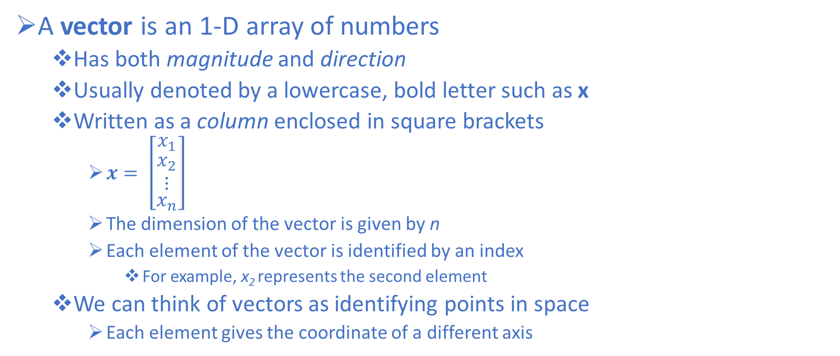
Linear Algebra
A vector is an 1-D array of numbers
Has both magnitude and direction
Usually denoted by a lowercase, bold letter such as x
Written as a column enclosed in square brackets
$x= \left[\begin{matrix}x_{1} \\ \begin{matrix}x_{2} \\ ⋮\end{matrix} \\ x_{n}\end{matrix}\right]$
The dimension of the vector is given by n
Each element of the vector is identified by an index
For example, x₂ represents the second element
We can think of vectors as identifying points in space
Each element gives the coordinate of a different axis
Notes:
http://www.deeplearningbook.org/contents/linear_algebra.html

Slide 28
Linear Algebra
# vector is 1-D array
>>> import numpy as np
>>> a = np.arange(4)
>>> a
array([0, 1, 2, 3])
# check number of dimensions
>>> a.ndim
1
# check the number of rows and columns
>>> a.shape
(4,)

Slide 29
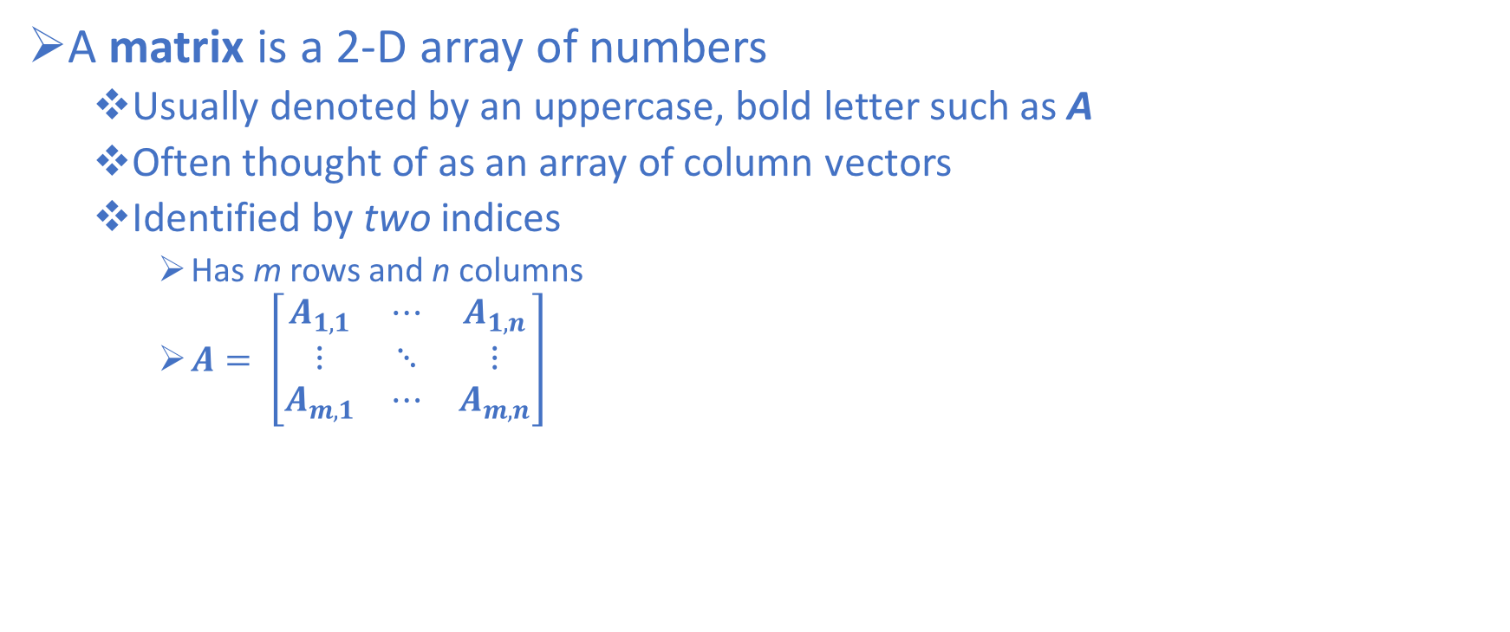
Linear Algebra
A matrix is a 2-D array of numbers
Usually denoted by an uppercase, bold letter such as A
Often thought of as an array of column vectors
Identified by two indices
Has m rows and n columns
$A= \left[\begin{matrix}A_{1,1} & ⋯ & A_{1,n} \\ ⋮ & ⋱ & ⋮ \\ A_{m,1} & ⋯ & A_{m,n}\end{matrix}\right]$

Slide 30
Linear Algebra
# matrix is 2-D array
>>> a = np.arange(4).reshape(2,2)
>>> a
array([[0, 1],
[2, 3]])
# check number of dimensions
>>> a.ndim
2
# check the number of rows and columns
>>> a.shape
(2, 2)

Slide 31
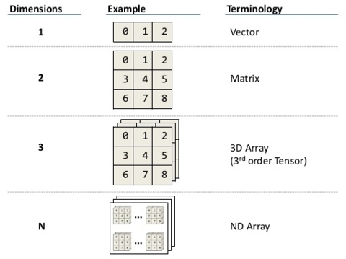
Linear Algebra
A tensor is a generalization of vectors and matrices to higher dimensions
# tensor is higher dimensional array
>>> a.reshape(1, 2, 2)
array([[[0, 1],
[2, 3]]])
>>> a.reshape(1, 2, 2).shape
(1, 2, 2)
>>> a.reshape(1, 2, 2).ndim
3

Slide 32
Linear Algebra
Transpose of vectors and matrices
The transpose of a vector or matrix is when we reflect it across the main diagonal
More simply: Swap the rows and columns

Slide 33
Linear Algebra
# transposing vectors
>>> a = np.arange(5)
>>> a
array([0, 1, 2, 3, 4])
>>> a.shape
(5,)
# method to transpose
>>> a.T
array([0, 1, 2, 3, 4])
>>> a.T.shape
(5,)
# function to transpose
>>> np.transpose(a)
array([0, 1, 2, 3, 4])
>>> np.transpose(a).shape
(5,)
Why didn’t anything happen?

Slide 34
Linear Algebra
# transposing vectors continued
>>> a.reshape(-1,1)
array([[0],
[1],
[2],
[3],
[4]])
>>> a.reshape(-1,1).shape
(5, 1)
>>> a.reshape(-1,1).T
array([[0, 1, 2, 3, 4]])
>>> a.reshape(-1,1).T.shape
(1, 5)

Slide 35
Linear Algebra
# transposing matrices
>>> b = np.arange(9).reshape(3,3)
>>> b
array([[0, 1, 2],
[3, 4, 5],
[6, 7, 8]])
>>> b.T
array([[0, 3, 6],
[1, 4, 7],
[2, 5, 8]])
>>> b.transpose()
array([[0, 3, 6],
[1, 4, 7],
[2, 5, 8]])

Slide 36
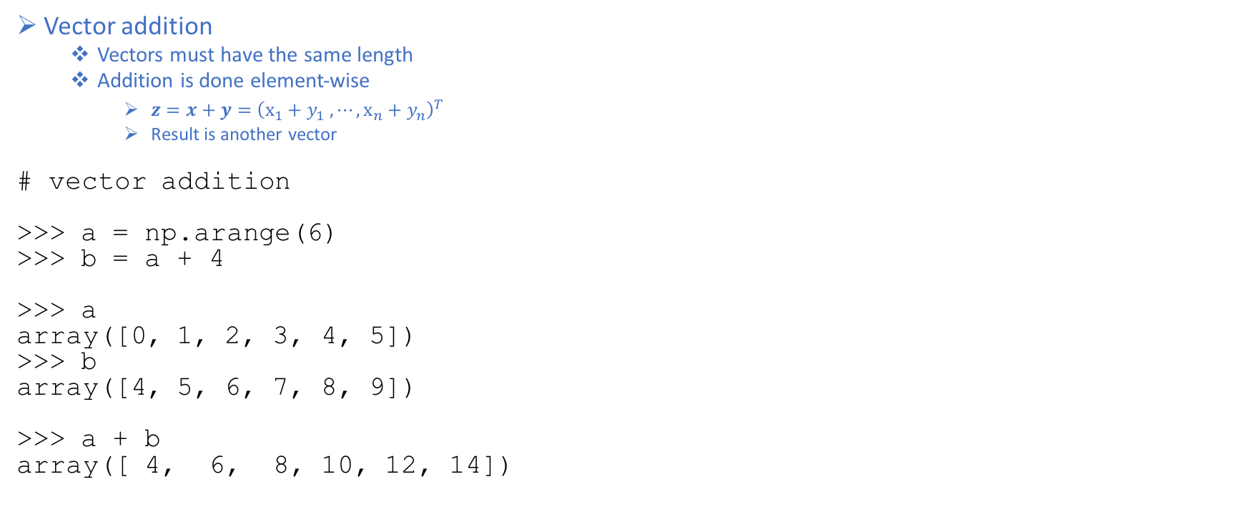
Linear Algebra
Vector addition
Vectors must have the same length
Addition is done element-wise
$z=x+y={\left(x_{1}+y_{1} , ⋯, x_{n}+y_{n}\right)}^{T}$
Result is another vector
# vector addition
>>> a = np.arange(6)
>>> b = a + 4
>>> a
array([0, 1, 2, 3, 4, 5])
>>> b
array([4, 5, 6, 7, 8, 9])
>>> a + b
array([ 4, 6, 8, 10, 12, 14])

Slide 37
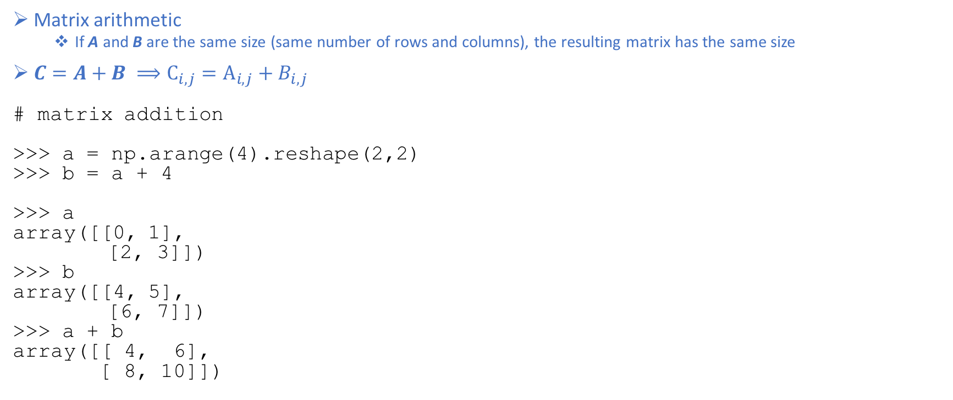
Linear Algebra
Matrix arithmetic
If A and B are the same size (same number of rows and columns), the resulting matrix has the same size
$C=A+B ⟹C_{i,j}=A_{i,j}+B_{i,j}$
# matrix addition
>>> a = np.arange(4).reshape(2,2)
>>> b = a + 4
>>> a
array([[0, 1],
[2, 3]])
>>> b
array([[4, 5],
[6, 7]])
>>> a + b
array([[ 4, 6],
[ 8, 10]])

Slide 38
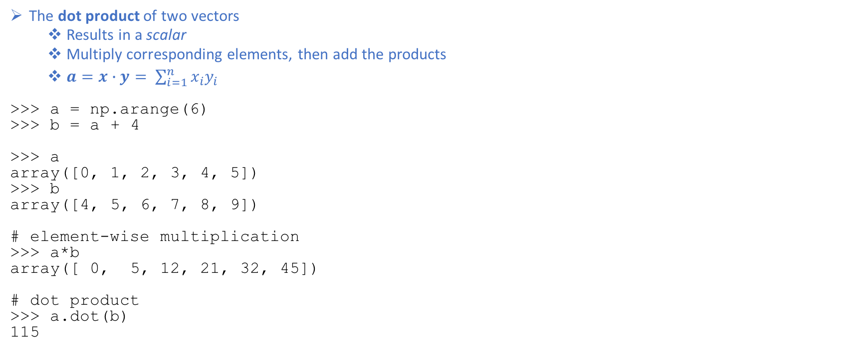
Linear Algebra
The dot product of two vectors
Results in a scalar
Multiply corresponding elements, then add the products
$a=x∙y= \sum_{i=1}^{n}{x_{i}y_{i}}$
>>> a = np.arange(6)
>>> b = a + 4
>>> a
array([0, 1, 2, 3, 4, 5])
>>> b
array([4, 5, 6, 7, 8, 9])
# element-wise multiplication
>>> a*b
array([ 0, 5, 12, 21, 32, 45])
# dot product
>>> a.dot(b)
115

Slide 39
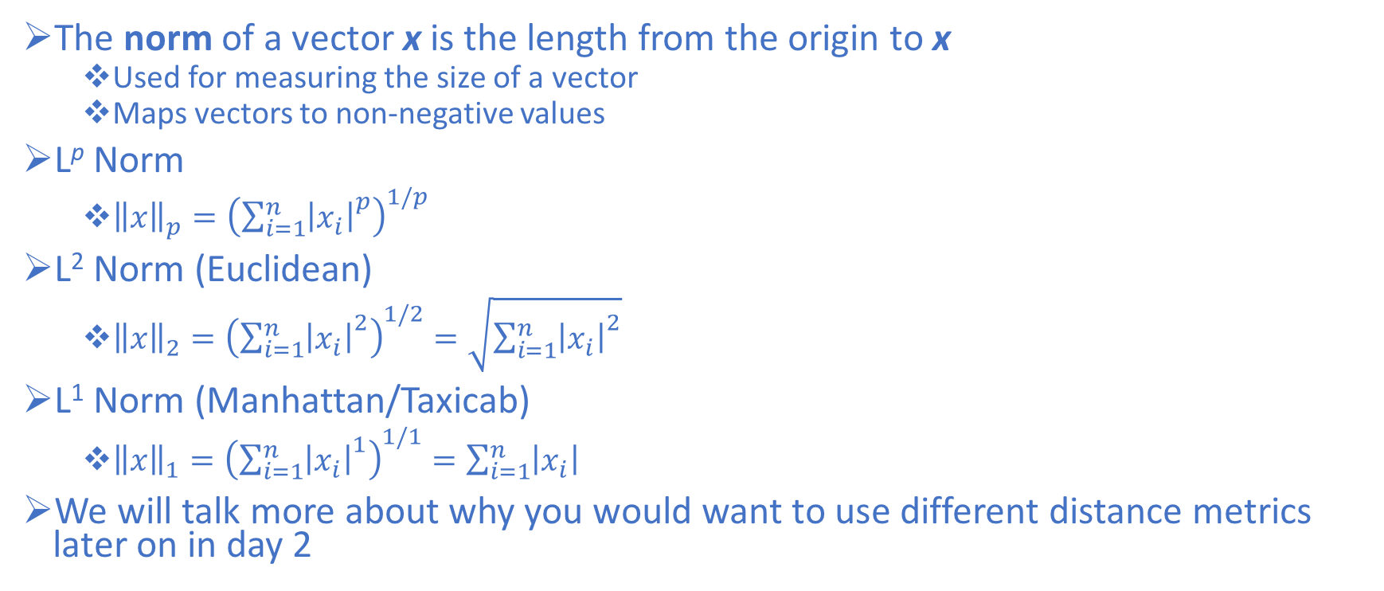
Linear Algebra
The norm of a vector x is the length from the origin to x
Used for measuring the size of a vector
Maps vectors to non-negative values
L^{p} Norm
${\left\|x\right\|}_{p}={\left({\sum_{i=1}^{n}{\left|x_{i}\right|}}^{p}\right)}^{1/p}$
L² Norm (Euclidean)
${\left\|x\right\|}_{2}={\left({\sum_{i=1}^{n}{\left|x_{i}\right|}}^{2}\right)}^{1/2}=\sqrt{{\sum_{i=1}^{n}{\left|x_{i}\right|}}^{2}}$
L¹ Norm (Manhattan/Taxicab)
${\left\|x\right\|}_{1}={\left({\sum_{i=1}^{n}{\left|x_{i}\right|}}^{1}\right)}^{1/1}=\sum_{i=1}^{n}{\left|x_{i}\right|}$
We will talk more about why you would want to use different distance metrics later on in day 2

Slide 40
Linear Algebra
>>> a = np.arange(6)
>>> a
array([0, 1, 2, 3, 4, 5])
# euclidean norm
>>> np.linalg.norm(a)
7.416198487095663
# taxicab norm
>>> np.linalg.norm(a, ord=1)
15.0

Slide 41
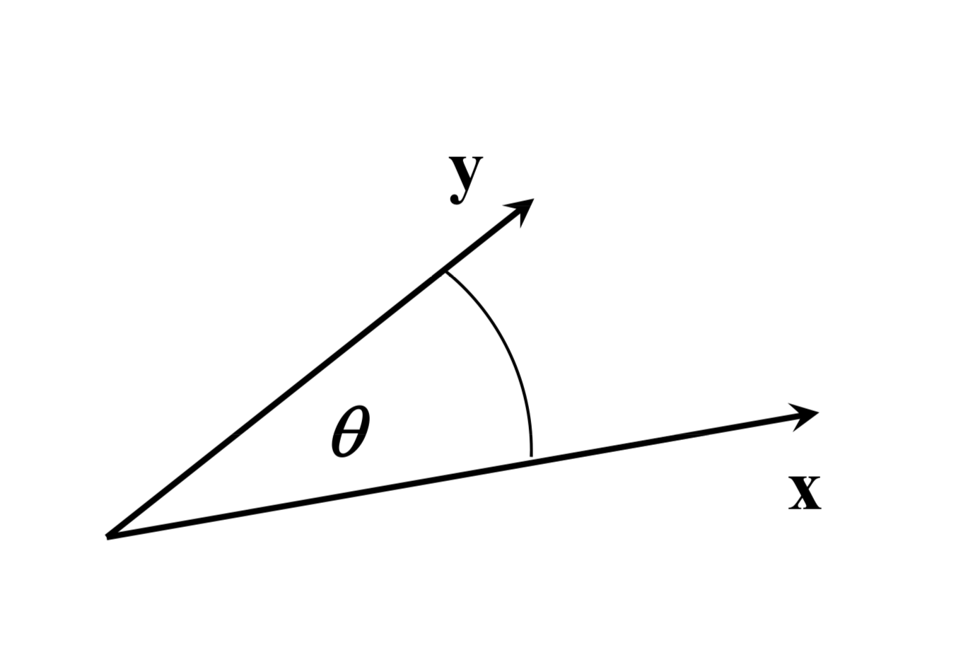
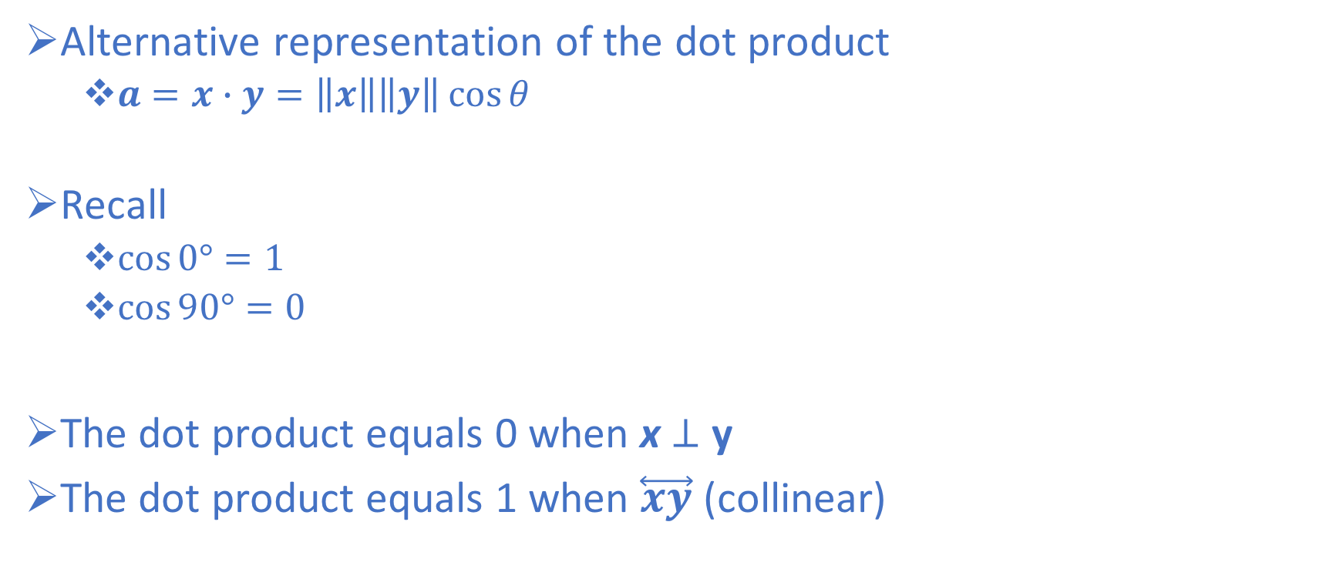
Linear Algebra
Alternative representation of the dot product
$a=x∙y=\left\|x\right\|\left\|y\right\|\cos{θ}$
Recall
$\cos{0°}=1$
$\cos{90°}=0$
The dot product equals 0 when x $⊥$ y
The dot product equals 1 when $\overset{⃡}{xy}$ (collinear)

Slide 42
Linear Algebra
Matrix multiplication
The inner dimension of the matrices have to match
In a chain of matrix multiplications, the column dimensions must match the row dimensions of the following matrix in the chain
The resulting size is the number of rows of the first and the number of columns of the second

Slide 43
Linear Algebra
>>> a = np.arange(4).reshape(2,2)
>>> b = a + 4
>>> a
array([[0, 1],
[2, 3]])
>>> b
array([[4, 5],
[6, 7]])
# element-wise multiplication
>>> a*b
array([[ 0, 5],
[12, 21]])
# matrix multiplication
>>> a.dot(b)
>>> a@b
>>> np.matmul(a,b)
array([[ 6, 7],
[26, 31]])

Slide 44
Linear Algebra
Matrix multiplication
Example matrices
A is 3x5
B is 5x1
C is 5x2
Can we compute?
AB
AC
BC
BA
CA

Slide 45
Linear Algebra
Matrix multiplication
Example matrices
A is 3x5
B is 5x1
C is 5x2
Can we compute?
AB ✅
AC ✅
BC ❌
BA ❌
CA ❌

Slide 46
Machine Learning Overview
There are several Python ML frameworks
This course will begin by using scikit-learn
One of the most popular and user-friendly machine learning libraries
Plays nice with Numpy, Pandas, & SciPy
Other ML/DL libraries to be aware of:
Keras
TensorFlow
Theano
Torch/Pytorch
Caffe/Caffe2
CNTK
MXNet
SparkML

Slide 47
Machine Learning Overview
scikit-learn is a python package that provides efficient implementations of most common ML algorithms via a simple API interface
scikit-learn has great online documentation
http://scikit-learn.org/stable/tutorial/machine_learning_map/index.html
Uniform syntax for “Estimators”
Once you know how to code one model, you can code them all

Slide 48
Machine Learning Overview
Standard ML workflow for classification:
Define the problem
Collect Data (with target labels)
Explore the Data (EDA)
Preprocess the Data
Fit Model on Training Set
Predict on Test Set
Evaluate Model Performance
Validate the Model
Improve Model Performance/Select the Best Model

Slide 49
Machine Learning Overview
Standard ML workflow for classification:
Define the problem
Collect Data (with target labels)
Explore the Data (EDA)
Preprocess the Data
Fit Model on Training Set
Predict on Test Set
Evaluate Model Performance
Validate the Model
Improve Model Performance/Select the Best Model

Slide 50
Define the Problem
What are we classifying?
Identify the target variable of interest
Decide how that variable ought to be measured
Choose a performance metric based on the goal
Accuracy is the simplest classification metric, but it may not be appropriate depending on the application
We want to find the metric closest to our business goal that is feasible to evaluate
We’ll circle back to performance metrics in model evaluation

Slide 51
Machine Learning Overview
Standard ML workflow for classification:
Define the problem
Collect Data (with target labels)
Explore the Data (EDA)
Preprocess the Data
Fit Model on Training Set
Predict on Test Set
Evaluate Model Performance
Validate the Model
Improve Model Performance/Select the Best Model

Slide 52
Machine Learning Overview
Standard ML workflow for classification:
Define the problem
Collect Data (with target labels)
Explore the Data (EDA)
Preprocess the Data
Fit Model on Training Set
Predict on Test Set
Evaluate Model Performance
Validate the Model
Improve Model Performance/Select the Best Model

Slide 53
Explore the Data
How big is the dataset?
What types of features do we have?
Do we have missing data?
Do we know why that data is missing?
How are the data distributed?
Class breakdown & Visualization

Slide 54
Machine Learning Overview
Standard ML workflow for classification:
Define the problem
Collect Data (with target labels)
Explore the Data (EDA)
Preprocess the Data
Fit Model on Training Set
Predict on Test Set
Evaluate Model Performance
Validate the Model
Improve Model Performance/Select the Best Model

Slide 55
Preprocess the Data
Imputing Missing Values
Method: mean, median, mode, interpolation, etc.
Sometimes makes sense to drop observation if it’s missing several measurements
Drop rows based on threshold criterion
Encoding Categorical Features
Method determined by whether feature is nominal or ordinal
Structuring Data for Modeling in scikit-learn
Scaling features
Normalization/Standardization
Engineering Features
Not explicitly covered in this course
This is where domain knowledge comes in hand

Slide 56
Dealing with Missing Data
What causes missing data?
Error in data collection
Certain measurements are “Not-Applicable”
Fields may have been left blank during data entry
Null values
NaN vs “ ” vs “_” vs “.” vs “N/A” vs “N-A”
What to do?
Impute
Mean
Median
Most Frequent Class
Forward-Fill
Back-Fill
Drop based on a missing-value threshold

Slide 57
Quantifying Missing Data
Count the number of missing values per column:
>>> df.isnull().sum()
Simply remove the corresponding samples from the dataset entirely:
# axis = 0 for rows
# axis = 1 for columns
>>> df.dropna(axis=0)
#only drop rows where all columns are NaN
>>> df.dropna(how = ‘all’)

Slide 58
Handling Missing Values
# drop rows that have less than 4 real values
>>> df.dropna(thresh = 4)
#only drop rows where NaN appear in specific columns (here: ‘C’)
>>> df.dropna(subset = [‘C’])

Slide 59
Imputing Missing Values
Usually we have too much valuable data to simply drop columns/rows, in this case we can fill the missing data (“imputation”)
>>> from sklearn.preprocessing import Imputer
>>> imr = Imputer(missing_values = ‘NaN’,
strategy = ‘mean’,
axis = 0)
>>> imr.fit(df.values)
>>> imputed_data = imr.transform(df.values)

Slide 60
Imputing Missing Values
Here, we replaced each “NaN” value with the corresponding mean, which is separately calculated for each feature column.
You can impute based on row means by setting axis = 1
Other imputation strategies that are available include setting the strategy parameter to:
median
replaces missing values with the median value
most_frequent (mode)
replaces missing values with the most frequent value in the column

Slide 61
Encoding Categorical Features
Nominal
Categorical features that don’t imply an order
T-shirt colors (Red, Blue, Green)
Animals (Dog, Cat, Fish, Tiger)
Ordinal
Categorical features that can be sorted or have an order
T-shirt size (S, M, L)
Quality (Poor, Fair, Good, Excellent)

Slide 62
Encoding Categorical Features
Let’s make a dummy dataset to walk through encoding categorical features
>>> import pandas as pd
>>> df = pd.DataFrame([
... ['green', 'M', 10.1, 'class1'],
... ['red', 'L', 13.5, 'class2'],
... ['blue', 'XL', 15.3, 'class1']])
>>> df.columns = ['color', 'size', 'price', 'classlabel']
>>> df
color size price classlabel
0 green M 10.1 class1
1 red L 13.5 class2
2 blue XL 15.3 class1

Slide 63
Encoding Categorical Features
Mapping Ordinal Features
To ensure the algorithm interprets the order appropriately, we need to convert the categorical string values into integers.
There is no function to automatically derive the correct order of the labels of our size feature, so we have to define the mapping manually
Assume the relation XL = L + 1 = M + 2 holds

Slide 64
Encoding Categorical Features
Mapping Ordinal Features
>>> size_mapping = {
... 'XL': 3,
... 'L': 2,
... 'M': 1}
>>> df['size'] = df['size'].map(size_mapping)
>>> df
color size price classlabel
0 green 1 10.1 class1
1 red 2 13.5 class2
2 blue 3 15.3 class1

Slide 65
Encoding Categorical Features
Inverse Mapping Ordinal Features
If want to recover the original string representation later on, we can define a reverse-mapping dictionary:
inv_size_mapping = {v: k for k, v in size_mapping.items()}
can use with pandas map() method on the transformed feature column, similar to the previous mapping
>>> inv_size_mapping = {v: k for k, v in size_mapping.items()}
>>> df['size'].map(inv_size_mapping)
0 M
1 L
2 XL
Name: size, dtype: object

Slide 66
Encoding Class Labels
Most sklearn classification estimators convert class labels to integers internally
Still good practice to provide class labels as integer arrays to avoid issues
Class labels are not ordinal
It doesn't matter which integer number we assign to a particular string label.
Thus, we can simply enumerate the class labels, starting at 0

Slide 67
Encoding Class Labels
The LabelEncoder class in sklearn does this for us:
>>> from sklearn.preprocessing import LabelEncoder
>>> class_le = LabelEncoder()
>>> y = class_le.fit_transform(df['classlabel'].values)
>>> y
array([0, 1, 0])

Slide 68
Encoding Class Labels
The LabelEncoder class in sklearn does this for us:
>>> from sklearn.preprocessing import LabelEncoder
>>> class_le = LabelEncoder()
>>> y = class_le.fit_transform(df['classlabel'].values)
>>> y
array([0, 1, 0])

Slide 69
Encoding Class Labels
Note that the fit_transform method is just a shortcut for calling fit and transform separately
fit makes the mapping
transform applies the mapping
we can use the inverse_transform method to transform the integer class labels back into their original string representation
>>> class_le.inverse_transform(y)
array(['class1', 'class2', 'class1'], dtype=object)

Slide 70
Performing One-Hot Encoding on Nominal Features
Sklearn treats class labels as nominal variables, so we were able to use the LabelEncoder to encode the strings as integers
We won’t be able to use this method for the nominal features in our data though
>>> X = df[['color', 'size', 'price']].values
>>> color_le = LabelEncoder()
>>> X[:, 0] = color_le.fit_transform(X[:, 0])
>>> X
array([[1, 1, 10.1],
[2, 2, 13.5],
[0, 3, 15.3]], dtype=object)

Slide 71
Performing One-Hot Encoding on Nominal Features
The new values for the color feature are as follows:
Blue = 0
Green = 1
Red = 2
Although the color values don't come in any particular order, the classifier will assume that green is larger than blue, and red is larger than green
The solution: One-hot encoding
Create a new dummy feature for each unique value in the nominal feature column

Slide 72
Performing One-Hot Encoding on Nominal Features
>>> from sklearn.preprocessing import OneHotEncoder
>>> ohe = OneHotEncoder(categorical_features=[0])
>>> ohe.fit_transform(X).toarray()
array([[ 0. , 1. , 0. , 1. , 10.1],
[ 0. , 0. , 1. , 2. , 13.5],
[ 1. , 0. , 0. , 3. , 15.3]])
Specify columns to one-hot encode when you instantiate
The OneHotEncoder returns a sparse matrix by default
We use toarray to see it
Could also instantiate OneHotEncoder with the sparse=False parameter

Slide 73
Performing One-Hot Encoding on Nominal Features
We can also do this with pandas:
>>> pd.get_dummies(df[['price', 'color', 'size']])
price size color_blue color_green color_red
0 10.1 1 0 1 0
1 13.5 2 0 0 1
2 15.3 3 1 0 0

Slide 74
Caution with One-Hot Encoding
One-Hot Encoding introduces multicollinearity to our dataset
Not great for methods that rely on matrix inversion
To reduce multicollinearity, we can drop columns that don’t give much additional info
If we remove the column color_blue, the feature information is still preserved since if we observe color_green=0 and color_red=0, it implies that the observation is blue
>>> pd.get_dummies(df[['price', 'color', 'size']],
... drop_first=True)
price size color_green color_red
0 10.1 1 1 0
1 13.5 2 0 1
2 15.3 3 0 0

Slide 75
Structuring Data for Modeling in Sklearn
Feature matrix (X)
Scikit-learn assumes a 2-D array of inputs with dimensions [n_samples, n_features]
Scikit-learn expects a feature matrix as a NumPy array or Pandas DataFrame
some Scikit-Learn models also accept SciPy sparse matrices.
Target vector (y)
Usually a column vector of length n_samples
scikit-learn expects a NumPy array or Pandas Series.

Slide 76
Structuring Data for Modeling in Sklearn

Slide 77
Structuring Data for Modeling in Sklearn
We’ve split our data up into a feature matrix & target vector, but we still aren’t ready to model it yet
If we fit our model to all the data and test the model on all the data, we would correctly predict almost every sample in the training set
Memorizing; not learning
Want our models to generalize
Perform well on unseen (out-of-sample) data
Holdout some data to test on
Split our data into a training set and test set
Learn parameters from the training set and predict/score on the test set

Slide 78
Structuring Data for Modeling in Sklearn
Sklearn’s train_test_split function does this for us
Its default parameter is to extract 75% for training and 25% for testing
>>> from sklearn.datasets import load_iris
>>> iris = load_iris()
>>> from sklearn.model_selection import train_test_split
>>> X_train, X_test, y_train, y_test = train_test_split(iris['data'], iris['target'], random_state=0)

Slide 79
Splitting into Training and Test Data
The train_test_split function shuffles the data with a pseudorandom number generator before splitting
Without shuffling the iris data, we would only have class 2 in the test set
To make sure we get the same splits, we set the seed with the random_state parameter
Dealing with imbalanced classes (credit fraud/cancer examples)
When dealing with imbalanced datasets, it is important to ensure the training and test set have the same proportions as the original dataset
We can do this by passing the target vector as an argument to the stratify parameter
train_test_split(iris['data'], iris['target'], random_state=0, stratify=y)

Slide 80
Scaling Features
Some algorithms are very sensitive to how the data are scaled
Neural networks → Vanishing gradient
There are four different ways to scale our data in sklearn:
StandardScaler
RobustScaler
MinMaxScaler
Normalizer

Slide 81
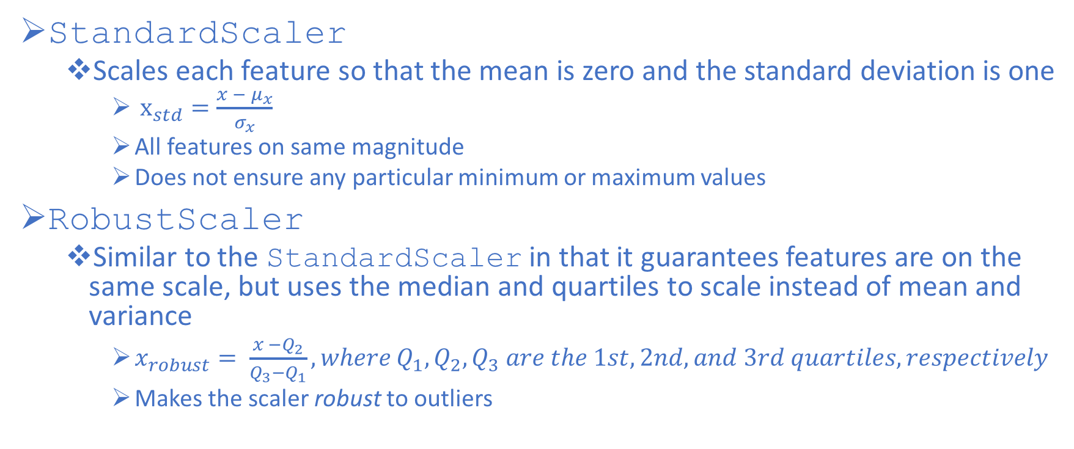
Scaling Features
StandardScaler
Scales each feature so that the mean is zero and the standard deviation is one
$x_{std}=\frac{x − μ_{x}}{σ_{x}}$
All features on same magnitude
Does not ensure any particular minimum or maximum values
RobustScaler
Similar to the StandardScaler in that it guarantees features are on the same scale, but uses the median and quartiles to scale instead of mean and variance
$x_{robust}= \frac{x −Q_{2}}{Q_{3}−Q_{1}}, where Q_{1}, Q_{2}, Q_{3} are the 1st, 2nd, and 3rd quartiles, respectively$
Makes the scaler robust to outliers

Slide 82
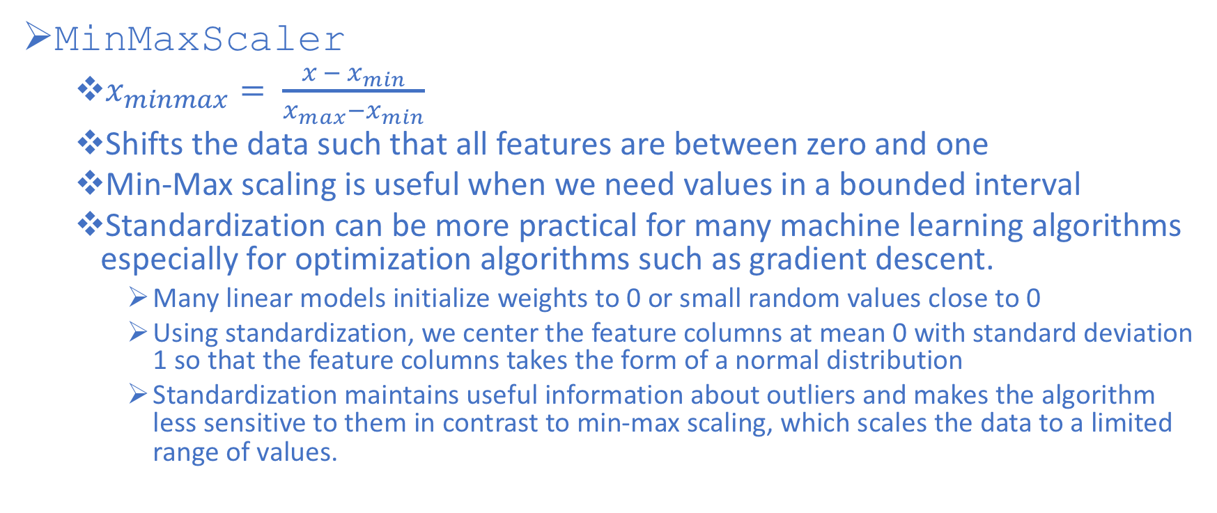
Scaling Features
MinMaxScaler
$x_{minmax}= \frac{{x − x}_{min}}{x_{max}−x_{min}}$
Shifts the data such that all features are between zero and one
Min-Max scaling is useful when we need values in a bounded interval
Standardization can be more practical for many machine learning algorithms especially for optimization algorithms such as gradient descent.
Many linear models initialize weights to 0 or small random values close to 0
Using standardization, we center the feature columns at mean 0 with standard deviation 1 so that the feature columns takes the form of a normal distribution
Standardization maintains useful information about outliers and makes the algorithm less sensitive to them in contrast to min-max scaling, which scales the data to a limited range of values.

Slide 83
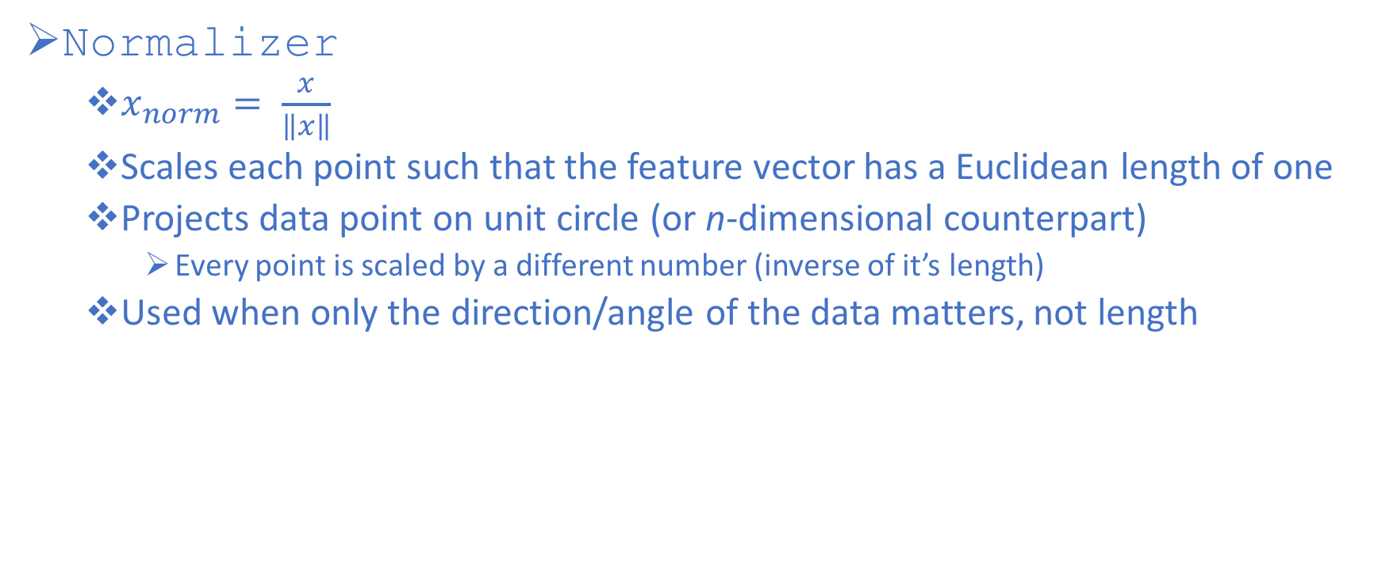
Scaling Features
Normalizer
$x_{norm}= \frac{x}{\left\|x\right\|}$
Scales each point such that the feature vector has a Euclidean length of one
Projects data point on unit circle (or n-dimensional counterpart)
Every point is scaled by a different number (inverse of it’s length)
Used when only the direction/angle of the data matters, not length

Slide 84
Scaling Example
Open up the feature-scaling.py script to see the different scaling methods in action

Slide 85
Feature Engineering & Feature Selection
Feature Engineering is the process of determining how to best represent your data for a particular application
Some would consider encoding categorical features to be part of this process
Encoding categorical features vs discretizing continuous variables/interaction terms/polynomial features/transformations
Case-by-case and model-dependent
No need to scale features for tree-based methods
Very important to scale features for k-NN & neural networks
Industry knowledge is very helpful at this stage

Slide 86
Feature Engineering & Feature Selection
Encoding and engineering features can cause us to increase the dimensionality of the data greatly beyond the original number of features
When adding new features in this way, or with high-dimensional datasets in general, it’s a good idea to reduce the number of features to only the most useful ones
This can lead to simpler models that generalize better
Feature Selection is the process of determining which features to include in our model
Three main methods:
Univariate Statistics (ANOVA)
Model-based Feature Selection (Trees & LASSO)
Iterative Feature Selection (RFE)

Slide 87
Machine Learning Overview
Standard ML workflow for classification:
Define the problem
Collect Data (with target labels)
Explore the Data (EDA)
Preprocess the Data
Fit Model on Training Set
Predict on Test Set
Evaluate Model Performance
Validate the Model
Improve Model Performance/Select the Best Model

Slide 88
Scikit-learn Estimator – Steps to Fit a Model & Generate Predictions
Import appropriate estimator from scikit-learn
Instantiate estimator with desired hyperparameters
Fit the model by calling the fit() method on the training set
What’s really happening here?
The model is learning the relationship between the features/inputs and the response/target
Note: All learned parameters are stored as names with trailing underscores
Predict on unseen data (test set):
Predict labels with predict()method

Slide 89
Scikit-learn Estimator – Steps to Fit a Model & Generate Predictions
# import sklearn methods and estimator
>>> from sklearn.datasets import load_iris
>>> from sklearn.model_selection import train_test_split
>>> from sklearn.neighbors import KNeighborsClassifier
>>> iris = load_iris()
# feature matrix and target vector
>>> X = iris.data
>>> y = iris.target
# split into training and test set
>>> X_train, X_test, y_train, y_test = train_test_split(X, y, random_state=0)
# instantiate estimator
>>> knn = KNeighborsClassifier(n_neighbors=1)
# fit on training set to ’learn’ parameters
>>> knn.fit(X_train, y_train)
# predict on the test set
>>> y_pred = knn.predict(X_test)

Slide 90
Machine Learning Overview
Standard ML workflow for classification:
Define the problem
Collect Data (with target labels)
Explore the Data (EDA)
Preprocess the Data
Fit Model on Training Set
Predict on Test Set
Evaluate Model Performance
Validate the Model
Improve Model Performance/Select the Best Model

Slide 91
Performance Metrics for Binary Classification Models
In binary classification, we have 2 classes—positive and negative
Accuracy: Fraction of correctly classified samples
number correctly classified / total number of samples
(TP+TN)/total
A True Positive is when the sample is from the positive class and we correctly predict the positive class
A True Negative is when the sample is from the negative class and we correctly predict the negative class
A False Positive is when the sample is from the negative class and we incorrectly predict the positive class (Type I Error)
A False Negative is when the sample is from the positive class and we incorrectly predict the negative class (Type II Error)

Slide 92
Performance Metrics for Binary Classification Models
Each estimator in scikit-learn has a score method that computes the default evaluation criterion for the problem they are designed to solve
For almost all classifiers, this will be accuracy
In our previous example, the following command would calculate the accuracy of the classifier:
knn.score(X_test, y_test)
0.97368421052631582
There are also explicit functions in scikit-learn for all the performance metrics

Slide 93
Accuracy in sklearn
>>> import numpy as np
>>> from sklearn.metrics import accuracy_score
>>> y_pred = [0, 2, 1, 3]
>>> y_true = [0, 1, 2, 3]
# fraction of classified samples
>>> accuracy_score(y_true, y_pred)
0.5
# number of correctly classified samples
>>> accuracy_score(y_true, y_pred, normalize=False)
2

Slide 94
When Would You Not Want to Use Accuracy?
When the number of mistakes does not contain all the information we are interested in
Example: Imagine an automated application to screen for the early detection of cancer. If the test is negative, we assume the patient is healthy, and if the test is positive, the patient will undergo additional screening.
Positive Test → Cancer
Negative Test → Healthy
Our model is never going to be going to be perfect

Slide 95
When Would You Not Want to Use Accuracy?
What are the consequences of being wrong?
Healthy patient is told they have cancer (False Positive)
Costs and inconvenience to patient
Sick patient is told they are healthy (False Negative)
Patient will not receive further tests & treatment
Undiagnosed cancer could lead to serious issues or ☠️
We obviously want to avoid False Negatives as much as possible in this example

Slide 96
When Would You Not Want to Use Accuracy?
We run into the same issue with imbalanced datasets
Example: Imagine we are looking at credit fraud data where 99% of the transactions were not fraudulent and 1% were fraudulent
Say we build a complex ML model that has 99% accuracy in predicting whether a transaction is fraudulent or not
Is this actually good?
We can just guess every single time that every transaction is not fraudulent and get an accuracy of 99%
We actually don’t know if the model is good because accuracy doesn’t give us enough information as to how predictions were made

Slide 97
Confusion Matrix
The confusion matrix is a more informative way to represent the results of a binary classifier

Slide 98
Confusion Matrix
165 total observations/predictions

Slide 99
Confusion Matrix
Of the 165 total observations, we predicted yes 110 times

Slide 100
Confusion Matrix
Of the 165 total observations, we predicted no 55 times

Slide 101
Confusion Matrix
Of the 165 total observations, 105 are actually yes

Slide 102
Confusion Matrix
Of the 165 total observations, 60 are actually no

Slide 103
Confusion Matrix
Diagonal terms are correct classifications

Slide 104
Confusion Matrix
Accuracy = (TN + TP) / total = (100 + 50) / 165 = 0.91

Slide 105
Confusion Matrix in sklearn
>>> from sklearn.metrics import confusion_matrix
>>> y_true = [0, 1, 0, 1]
>>> y_pred = [1, 1, 1, 0]
>>> confusion_matrix(y_true, y_pred)
array([[0, 2],
[1, 1]])
# we can extract the following info in the binary case
>>> tn, fp, fn, tp = confusion_matrix(y_true, y_pred).ravel()
>>> print((tn, fp, fn, tp))
(0, 2, 1, 1)

Slide 106
Metrics Derived from Confusion Matrix
Misclassification Rate: Proportion incorrectly classified
(FP+FN)/total
Misclassification rate = 1 – Accuracy
Precision: When it predicts yes, how often is it correct?
TP/(TP + FP)
Bounded between [0,1] where 1 is the best
Used when the goal is to limit the number of false positives
Clinical trials are expensive, so you want to know a drug works before investing in them
Recall (True Positive Rate): When it's actually yes, how often does it predict yes?
TP/(TP + FN)
Bounded between [0,1] where 1 is the best
Used when we need to identify all positive samples (avoid false negatives)
Cancer example

Slide 107
Confusion Matrix
Misclassification Rate = (FP+FN) / total = (10 + 5) / 165 = 0.09

Slide 108
Confusion Matrix
Precision = TP / (TP + FP) = 100 / (100 + 10) = 0.91

Slide 109
Confusion Matrix
Recall = TP / (TP + FN) = 100 / (100 + 5) = 0.95

Slide 110
Misclassification Rate, Precision, & Recall in sklearn
>>> from sklearn.metrics import accuracy_score, precision_score, recall_score
>>> miss_rate = 1 - accuracy_score(y_true, y_pred)
>>> precision = precision_score(y_true, y_pred)
>>> recall = recall_score(y_true,y_pred)
>>> print("Misclassification Rate: {:03.2f}".format(miss_rate))
>>> print("Precision: {:03.2f}".format(precision))
>>> print("Recall: {:03.2f}".format(recall))
Misclassification Rate: 0.75
Precision: 0.33
Recall: 0.50

Slide 111
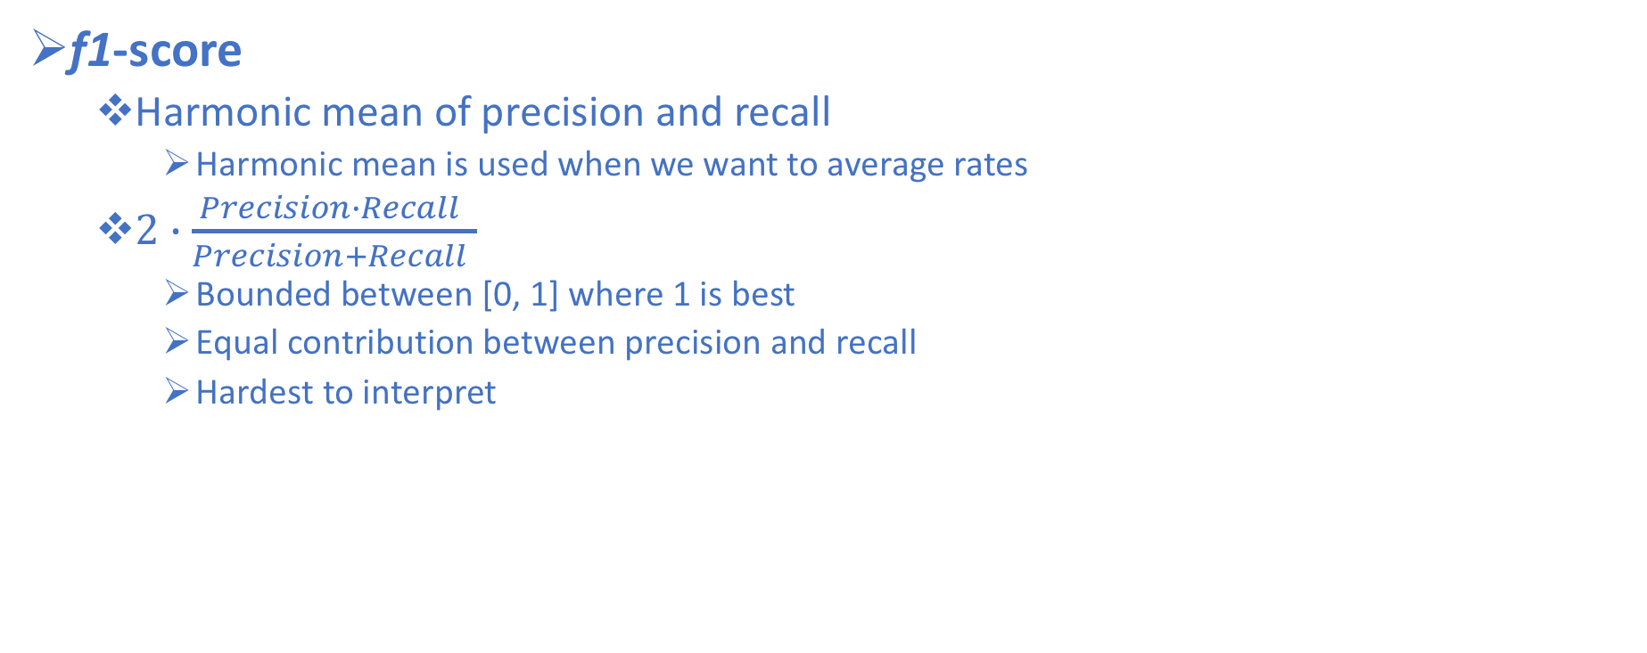
Metrics from Confusion Matrix
f1-score
Harmonic mean of precision and recall
Harmonic mean is used when we want to average rates
$2∙\frac{Precision∙Recall }{Precision+Recall }$
Bounded between [0, 1] where 1 is best
Equal contribution between precision and recall
Hardest to interpret

Slide 112
f1-score in sklearn
>>> from sklearn.metrics import f1_score
>>> print("f1-score: {:03.2f}".format(f1_score(y_true, y_pred)))
# can do precision, recall, and f1 all together
from sklearn.metrics import classification_report
print(classification_report(y_true, y_pred))
precision recall f1-score support
0 0.00 0.00 0.00 2
1 0.33 0.50 0.40 2
avg / total 0.17 0.25 0.20 4

Slide 113
Performance Metrics for Binary Classification Models
The confusion matrix and classification report provided much more information about the predictions than accuracy
But, can we get even more information?
Yes!
We can take uncertainty into account too
Most classifiers in sklearn have either a decision_function or predict_proba method
Predictions can be seen as thresholding the output of one of these functions
decision_function represents the signed difference of an observation to the plane
Assigns all points with a value greater than zero to the positive class
predict_proba represents the predicted probability of belonging to each class
Assigns the point to class based on highest probability

Slide 114
Thresholding
Depending on the end goal, we can adjust the decision threshold for the probability function
Recall the cancer screening example where we want a high recall for the positive class
Willing to risk more false positives in order to reduce false negatives
We might consider decreasing the threshold on the predictions in order to increase the recall
Recall = TP / (TP + FN)
Precision = TP / (TP + FP)
Decrease FN → Increase Recall
Increase FP → Decrease Precision
Adjusting the threshold is a trade-off between precision and recall
You should NEVER set your threshold based on the test set
Always use the training or validation set to determine your optimal threshold

Slide 115
Precision-Recall Curves
Thresholding is particularly helpful when we have a set precision or recall score determined by the business project
Once a precision or recall score is set, a threshold can be set
Most of the time, we do not have a set point and may wish to look at all possible thresholds and trade-offs at once
We can do this with the precision-recall curve

Slide 116
Precision-Recall Curve in sklearn
>>> from sklearn.metrics import precision_recall_curve
>>> precision,recall,thresholds = precision_recall_curve(y_test, model.decision_function(X_test))
The precision_recall_curve function returns a list of precision and recall values for all possible thresholds (all values that appear in the decision function) in sorted order
We can use this to plot the curve

Slide 117
Precision-Recall Curve in sklearn
# find threshold closest to zero:
>>> close_zero = np.argmin(np.abs(thresholds))
>>> plt.plot(precision[close_zero], recall[close_zero], 'o', markersize=10, label="threshold zero", fillstyle="none", c='k', mew=2)
>>> plt.plot(precision, recall, label="precision recall curve")
>>> plt.xlabel("precision")
>>> plt.ylabel("recall")
>>> plt.title("precision_recall_curve")
>>> plt.legend(loc="best")

Slide 118
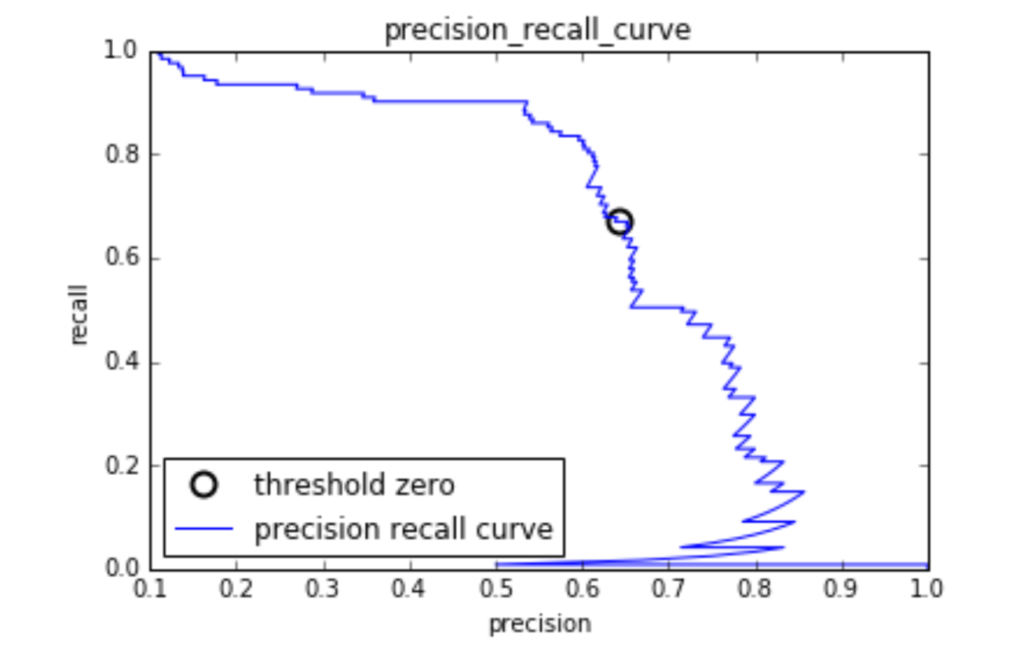
Precision-Recall Curves
Each point along the curve corresponds to a possible threshold from either predict_proba or decision_function

Slide 119
Precision-Recall Curves
We can write code to find the threshold closest to zero in the list of returned thresholds and plot it to see where the default decision threshold is

Slide 120
Precision-Recall Curves
The closer a curve stays to the upper-right corner, the better the classifier
A point in the upper-right means a classifier has high precision & high recall

Slide 121
Precision-Recall Curves
The curve starts in the top-left corner, corresponding to a very low threshold, which classifies everything as the positive class

Slide 122
Precision-Recall Curves
Raising the threshold moves the curve towards higher precision and lower recall
The more our model keeps recall high while increasing precision, the better

Slide 123
Precision-Recall Curves
Looking at this curve, it is possible to achieve a much higher recall, while keeping precision above 0.5, by decreasing the threshold
In the cancer example, we would consider moving the threshold to the one in the green circle

Slide 124
Precision-Recall Curves
Conversely, in this example, getting a high precision is very costly
This flat region allows us to increase precision at very little cost to recall
But, for each increase in precision past 0.5, it costs us a lot of recall (evidenced by the steep slope)

Slide 125
Precision-Recall Curves
Conversely, in this example, getting a high precision is very costly
This flat region allows us to increase precision at very little cost to recall
But, for each increase in precision past 0.5, it costs us a lot of recall (evidenced by the steep slope)

Slide 126
Precision-Recall Curves
Conversely, in this example, getting a high precision is very costly
This flat region allows us to increase precision at very little cost to recall
But, for each increase in precision past 0.5, it costs us a lot of recall (evidenced by the steep slope)

Slide 127
ROC Curve
Another common tool to evaluate a model at different thresholds is the Receiver Operating Characteristics (ROC) Curve
The ROC curve similarly considers all possible thresholds for a given classifier
But, instead of reporting precision and recall, it shows the false positive rate (FPR) against the true positive rate (TPR)
Note: the true positive rate is simply another name for recall, while the false positive rate is the fraction of false positives out of all negative samples

Slide 128
ROC Curve in sklearn
>>> from sklearn.metrics import roc_curve
>>> fpr, tpr, thresholds = roc_curve(y_test, model.decision_function(X_test))
The roc_curve function returns a list of false positive rates and true positive rates for all possible thresholds (all values that appear in the decision function) in sorted order
We can use this to plot the curve

Slide 129
ROC Curve in sklearn
# find threshold closest to zero:close_zero = np.argmin(np.abs(thresholds))
plt.plot(fpr[close_zero], tpr[close_zero], 'o', markersize=10, label="threshold zero", fillstyle="none", c='k', mew=2)
plt.legend(loc=4)
plt.plot(fpr, tpr, label="ROC Curve")
plt.xlabel("FPR")
plt.ylabel("TPR (recall)")
plt.title("roc_curve")

Slide 130
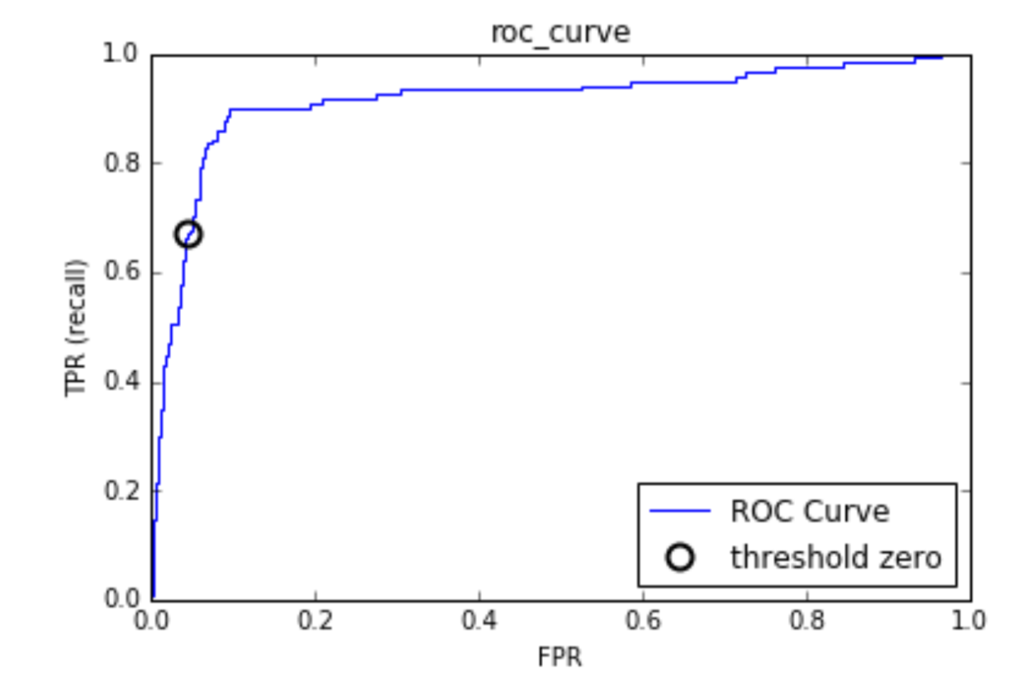
ROC Curve
For the ROC curve, the ideal curve is close to the top left—you want a classifier that produces a high recall while keeping a low false positive rate.

Slide 131
ROC Curve
Compared to the default threshold of zero, the curve shows that we could achieve a significantly higher recall (around 0.9) while only increasing the FPR slightly

Slide 132
AUC
If we want to summarize the ROC Curve, we can compute the area under the curve (AUC)
Bounded between [0, 1]
Predicting randomly always produces an AUC of 0.5, not matter how imbalanced the classes in a dataset are
This makes it a much better metric for imbalanced classification problems than accuracy
The AUC can be interpreted as evaluating the ranking of positive samples
If you randomly chose one positive and one negative observation, AUC represents the likelihood that your classifier will assign a higher predicted probability to the positive observation
An AUC of 1 means that all positive points have a higher score than all negative points

Slide 133
AUC in sklearn
>>> from sklearn.metrics import roc_auc_score
# use predicted probability for positive class
>>> auc = roc_auc_score(y_test, model.predict_proba(X_test)[:, 1])

Slide 134
ROC Curve & AUC
A perfect ROC curve is shown in green
If we draw a diagonal line on the ROC plot, this represents a model in which we guess randomly
Predicting randomly always produces an AUC of 0.5, no matter how imbalanced the classes in a dataset are
Our model should lie somewhere between the ideal curve and the diagonal line

Slide 135
ROC Curve & AUC
A perfect ROC curve is shown in green
If we draw a diagonal line on the ROC plot, this represents a model in which we guess randomly
Predicting randomly always produces an AUC of 0.5, no matter how imbalanced the classes in a dataset are
Our model should lie somewhere between the ideal curve and the diagonal line

Slide 136
ROC Curve & AUC
A perfect ROC curve is shown in green
If we draw a diagonal line on the ROC plot, this represents a model in which we guess randomly
Predicting randomly always produces an AUC of 0.5, no matter how imbalanced the classes in a dataset are
Our model should lie somewhere between the ideal curve and the diagonal line

Slide 137
ROC Curve & AUC
A perfect ROC curve is shown in green
If we draw a diagonal line on the ROC plot, this represents a model in which we guess randomly
Predicting randomly always produces an AUC of 0.5, no matter how imbalanced the classes in a dataset are
Our model should lie somewhere between the ideal curve and the diagonal line

Slide 138
Final Thoughts on ROC Curve & AUC
Keep in mind that AUC is just a calculation of the area under the ROC curve
It does not take the default threshold into account
We still need to look at the ROC Curve

Slide 139
Machine Learning Overview
Standard ML workflow for classification:
Define the problem
Collect Data (with target labels)
Explore the Data (EDA)
Preprocess the Data
Fit Model on Training Set
Predict on Test Set
Evaluate Model Performance
Validate the Model
Improve Model Performance/Select the Best Model

Slide 140
Model Validation
Recall: one of the main goals in building our classification model is for it perform well on unseen data (generalize)
For this reason, we split our data up into a training set and a test set
But, when we evaluate the performance of our model, we may find it performs much better on the training set than the test set
In this section, we will talk more about how to make our models generalize better and more robust methods for evaluating generalization performance than a simple split of the original data

Slide 141
Generalization, Overfitting, & Underfitting
If we notice our model performs much better on the training set than the test set, this is a strong indication of overfitting
Overfitting occurs when our model is too complex given the underlying training data
In this case, we say the model has high variance
Learning the random noise in the data, not the patterns
Conversely, Underfitting occurs when our model is not complex enough to capture the patterns in the training data well and also suffers from low performance on unseen data
In this case, we say the model has high bias

Slide 142
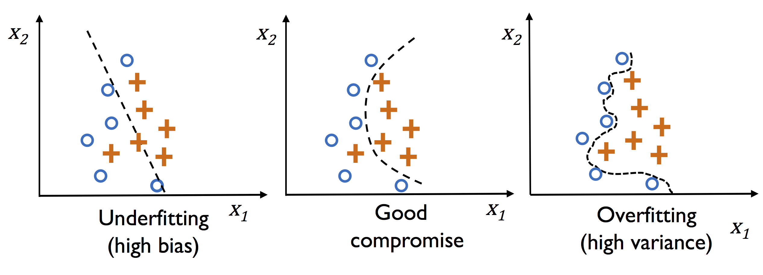
Generalization, Overfitting, & Underfitting

Slide 143
Generalization, Overfitting, & Underfitting
So we want to avoid overfitting because it gives too much predictive power to noise in our training data.
But in our attempt to reduce overfitting we can also begin to underfit or ignore important features in our training data
So how do we balance the two?
This is a problem we call the Bias-Variance Tradeoff

Slide 144
Bias-Variance Tradeoff
Variance measures the consistency (or variability) of the model prediction for a particular sample instance if we were to retrain the model multiple times on different subsets of the training dataset
The model is sensitive to the randomness in the training data
Bias measures how far off the predictions are from the correct values in general if we rebuild the model multiple times on different training datasets
Bias is the measure of the systematic error that is not due to randomness

Slide 145
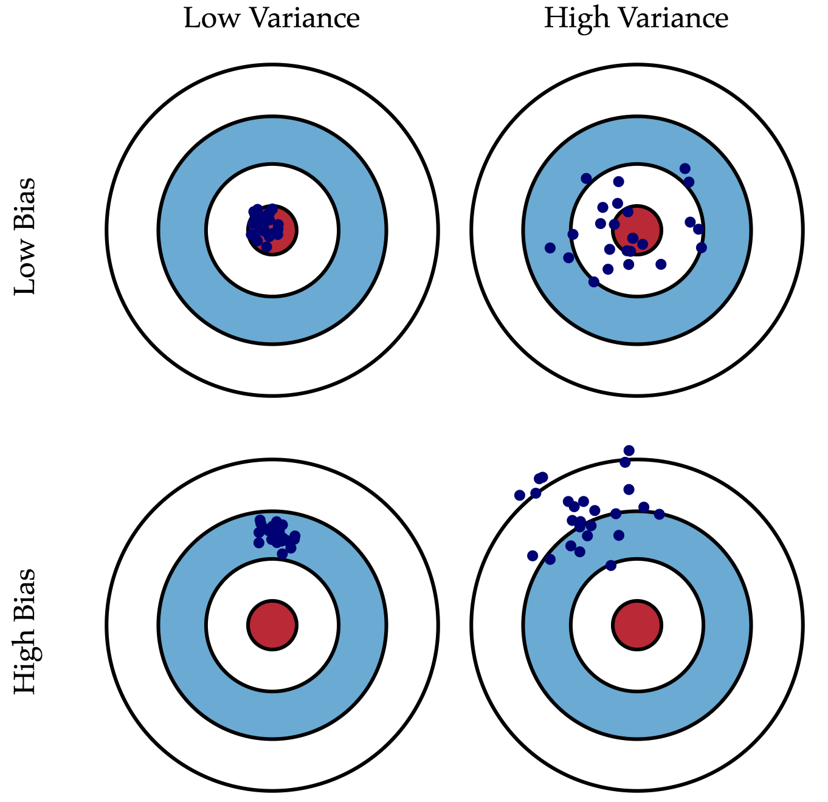
Bias-Variance Tradeoff

Slide 146
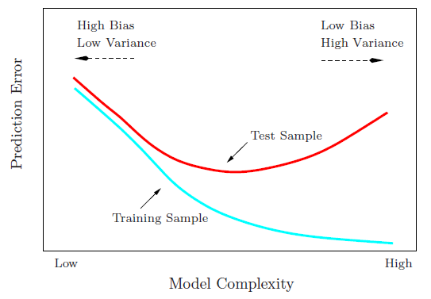
Bias-Variance Tradeoff

Slide 147
Bias-Variance Tradeoff
Low complexity models will result in high error (poor accuracy) for both training and test data. This is because the model lacks enough complexity to describe the data.

Slide 148
Bias-Variance Tradeoff
High complexity models will result in a low training error and a high test error. This is because a complex model will be able to model the training data a bit too well, and can’t generalize to the test data.

Slide 149
Bias-Variance Tradeoff
The best complexity lies where the test error reaches a minimum.

Slide 150
Bias-Variance Tradeoff
As we’ve seen, overfitting and underfitting have very clear signatures in training and test data
Overfitting results in low training error and high test error
Underfitting results in high training & test errors
To find an acceptable bias-variance tradeoff, we need to evaluate our model carefully
Often we use more robust methods than a simple training and test set split to find this tradeoff
Cross-validation

Slide 151
Cross-Validation
In cross-validation, instead of just splitting the data set in to a training set and a test set, the data is split repeatedly and multiple models are trained
The two most common methods are:
Holdout Cross-Validation
k-Fold Cross-Validation

Slide 152
Cross-Validation
Holdout Cross-Validation
Using the holdout method, we split our initial dataset into 3 separate sets:
Training (70 %)
Validation (15 %)
Testing (15 %)
The training set is used to fit the models, and the performance on the validation set is then used for the model selection
Model Selection is the process where we try to select the optimal values of tuning parameters (hyperparameters) for our models
The advantage of having a test set that the model hasn't seen before during the training and model selection steps is that we can obtain a less biased estimate of its ability to generalize to new data

Slide 153
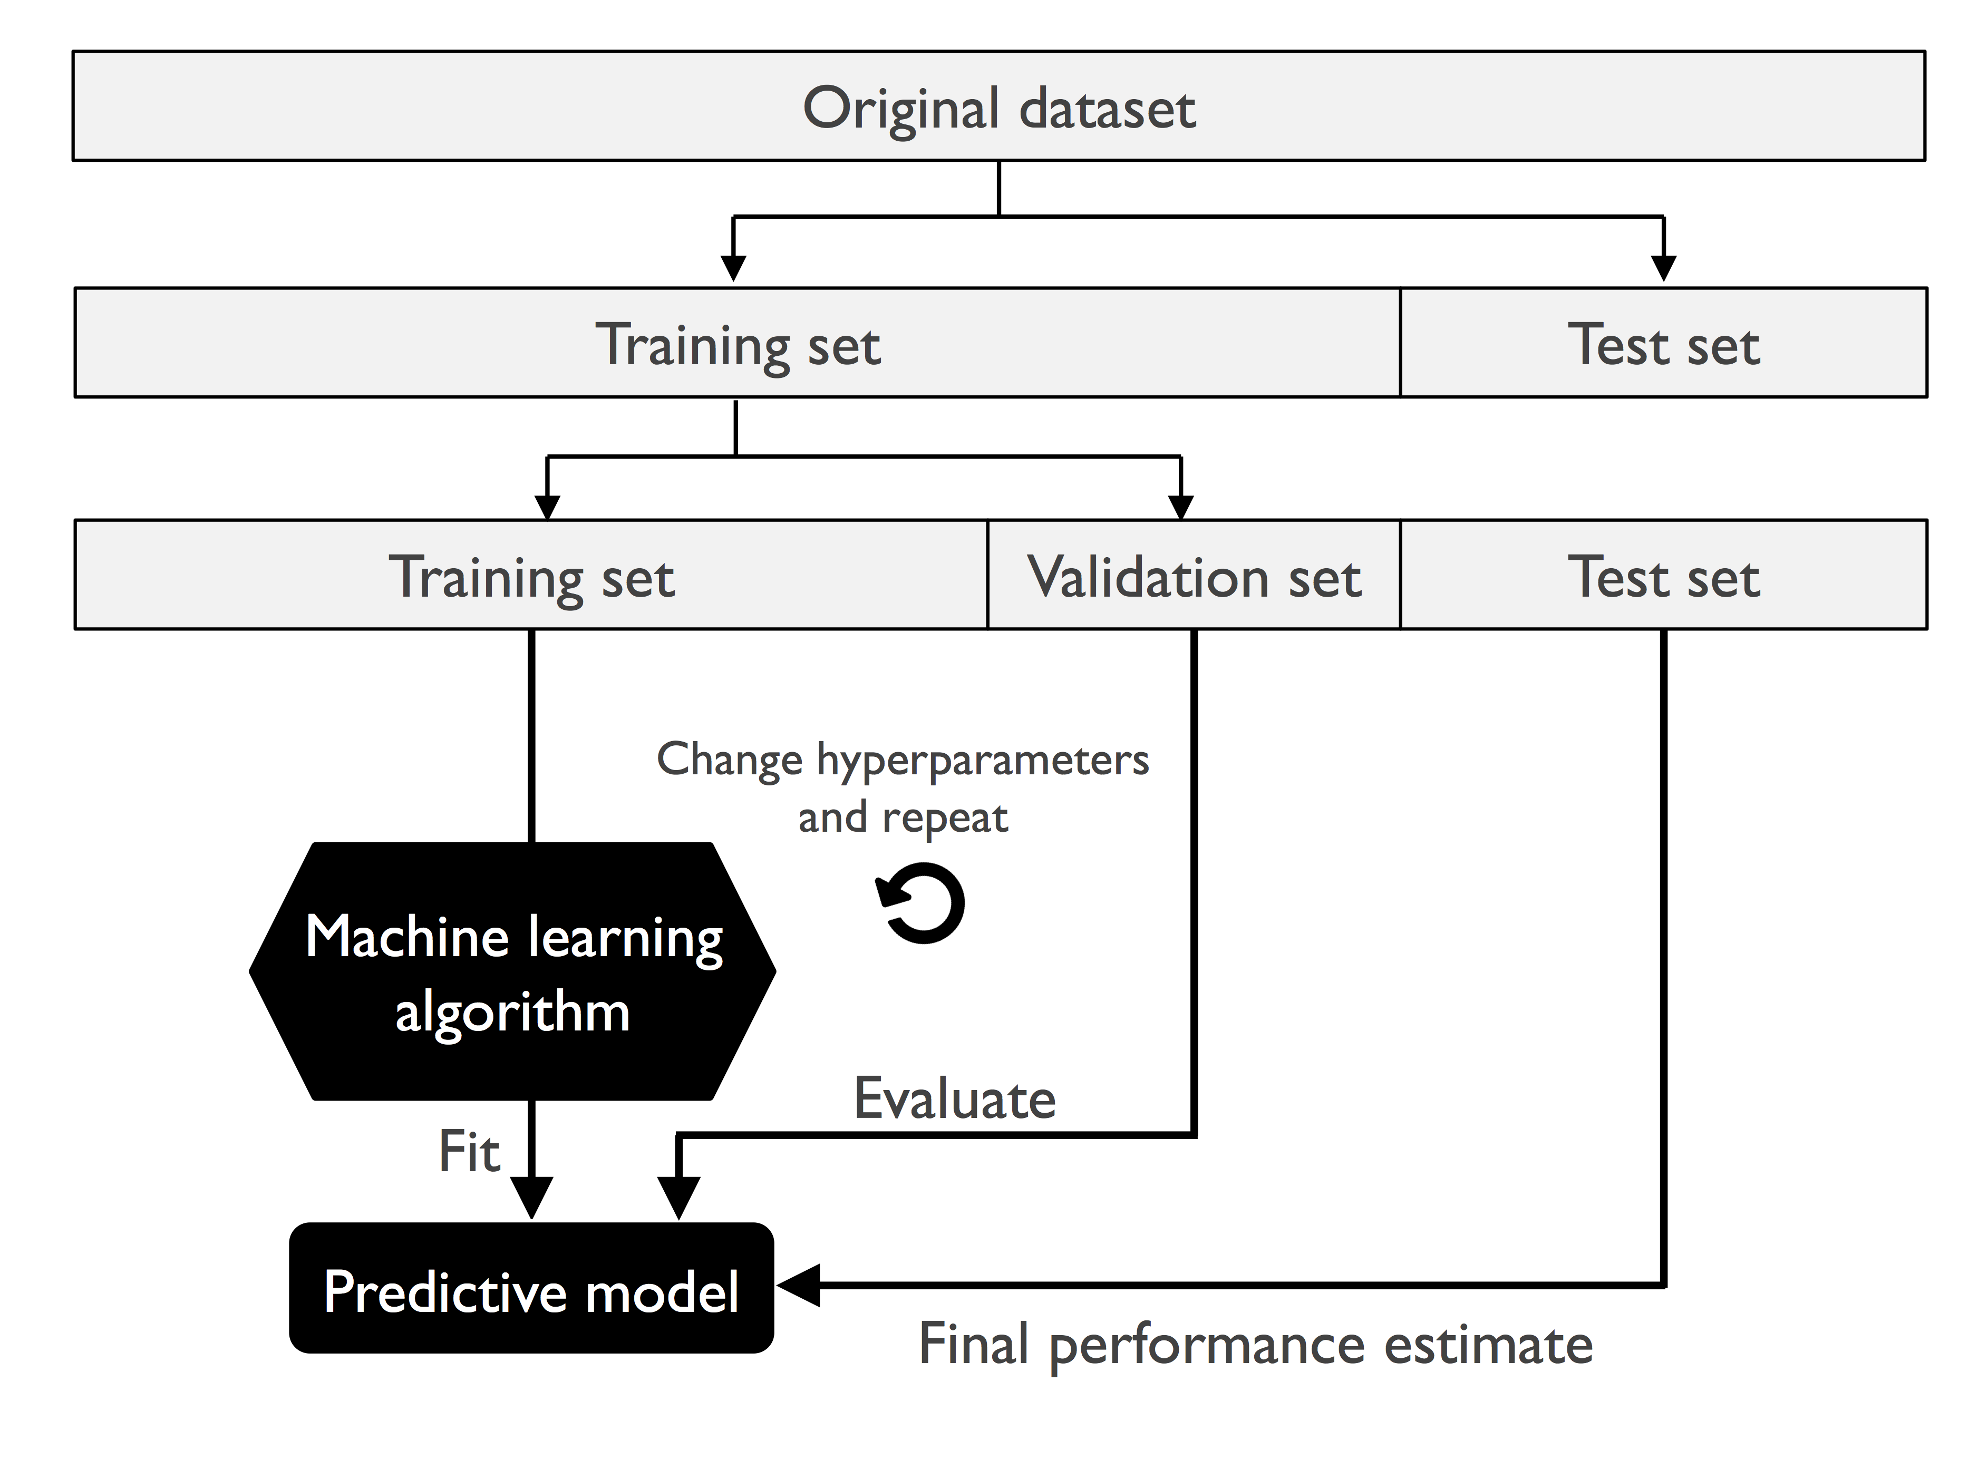
Holdout Cross-Validation

Slide 154
Cross-Validation
k-Fold Cross-Validation
In k-fold cross-validation, we randomly split the training dataset into k folds without replacement, where k-1 folds are used for the model training, and one fold is used for performance evaluation
This procedure is repeated k times so that we obtain k models and performance estimates

Slide 155
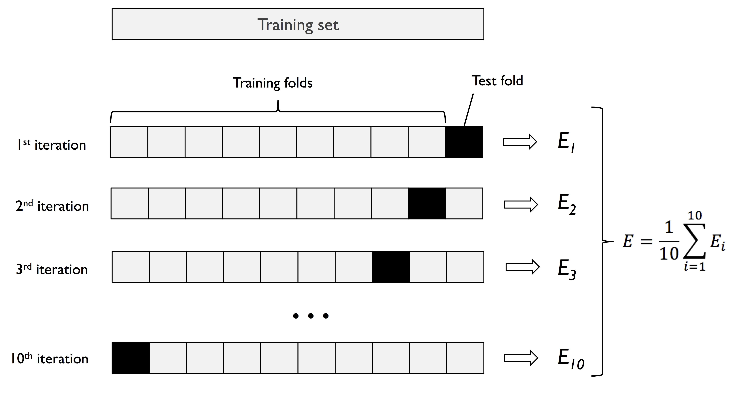
k-Fold Cross-Validation

Slide 156
k-Fold Cross-Validation
We then calculate the average performance of the models based on the different, independent folds to obtain a performance estimate that is less sensitive to the sub-partitioning of the training data compared to the holdout method
Generally use k-fold cross-validation for model tuning
Once we have found satisfactory hyperparameter values, we can retrain the model on the complete training set and obtain a final performance estimate using the independent test set

Slide 157
Machine Learning Overview
Standard ML workflow for classification:
Define the problem
Collect Data (with target labels)
Explore the Data (EDA)
Preprocess the Data
Fit Model on Training Set
Predict on Test Set
Evaluate Model Performance
Validate the Model
Improve Model Performance/Select the Best Model

Slide 158
Improve Model Performance/Select the Best Model
Gather more training samples
Not always possible
Merge additional datasets
Not always possible
Tune hyperparameters
This is model-specific and will be covered in the following days
Adjust model complexity & flexibility (bias-variance tradeoff)

Slide 159
Machine Learning Overview Wrap-up
Let’s do some more examples and exercises to reinforce the concepts from the machine learning overview!

